Slide 1




Improve Orphanet disease description knowledge by phenotypic automated recognition by using scrapping toolkits
David Lagorce david.lagorce@inserm.fr
Marc Hanauer marc.hanauer@inserm.fr

Slide 2
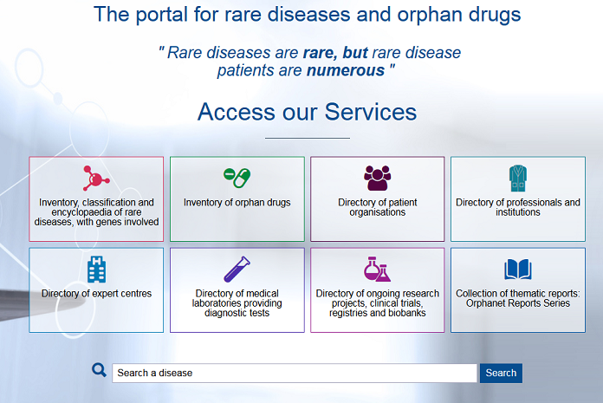
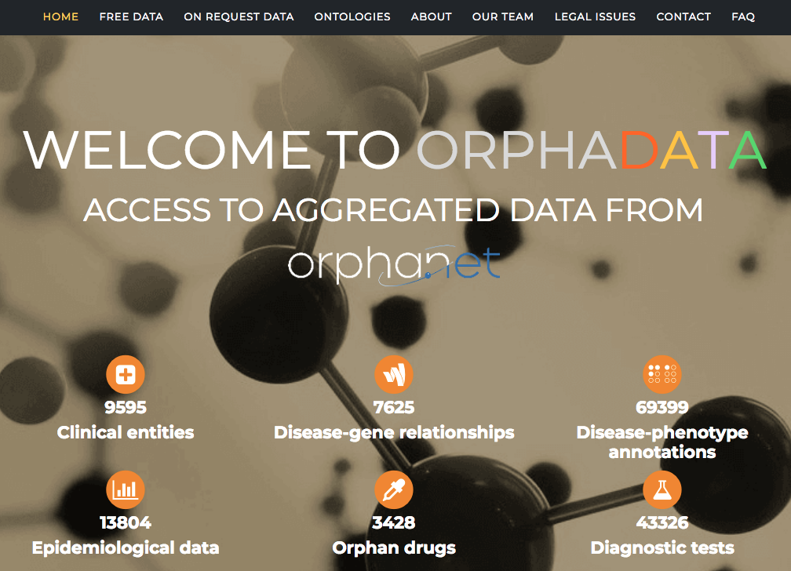


Background information - Context of the project
Mission:
collect
integrate
produce
disseminate
6000 Rare Diseases
Added-value data and information on RD
- manually curated,
- expert-reviewed,
- re-usable
5455 Disease definitions
Clinical descriptions
Textual Informations
2410
BioHackathon Paris – 12/16 Nov 2018
Notes:
Diapo de Charlotte: frise 20 ans

Slide 3

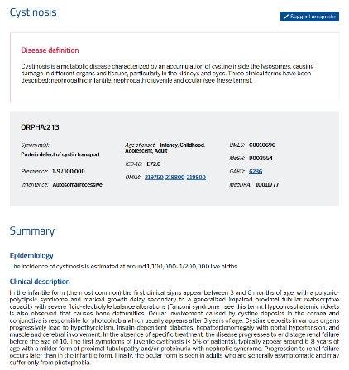
Background information - Context of the project
Human Phenotype Ontology
± 6000 Rare Diseases
phenotypes
69 195 annotations
3244 RD
5714 HPO
Frequencies | Diagnostic criteria
Obligate (100%) | Pathognomonic sign
Very frequent (99-80%) | Diagnostic criterion
Frequent (79-30%)
Occasional (29–5%)
Very rare (1-4%)
Absent 0%
Disseminated by Orphanet and HPO
Annotated by Orphanet
BioHackathon Paris – 12/16 Nov 2018
Notes:
Diapo de Charlotte: frise 20 ans

Slide 4
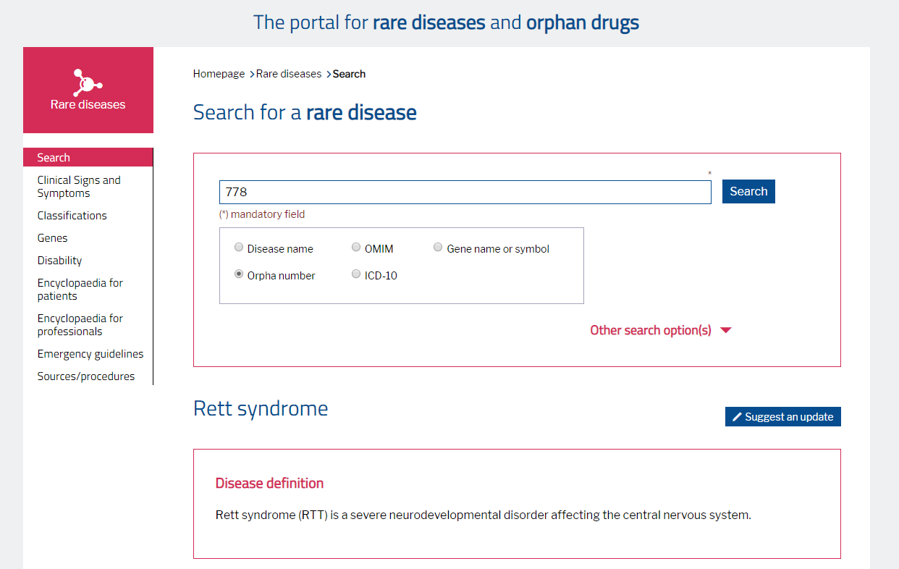
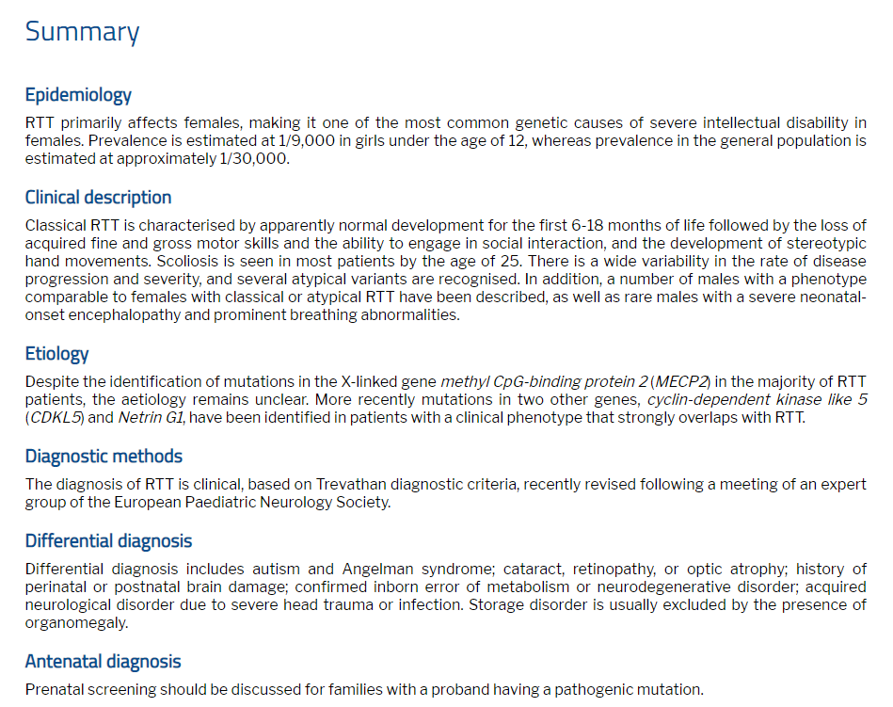
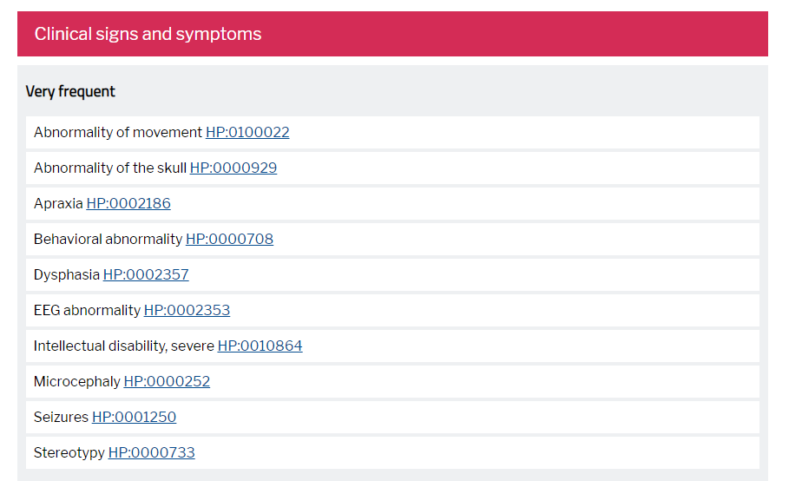
Background information - Context of the project
Human Phenotype Ontology
Phenotypes terms
Around 6,000 rare disorders
3244 RD
50%...
BioHackathon Paris – 12/16 Nov 2018
Notes:
Diapo de Charlotte: frise 20 ans

Slide 5
Expected Outcomes
We propose to try to use text-mining HPO terms recognition to :
speed-up the process of disease-HPO annotation of Orphanet knowledge.
improve the curation process by comparison between:
- the Orphanet's disease clinical description by automated recognition of HPO terms.
- the HPO annotations already provided by Orphanet for the same disease concept .
To this end, through a dedicated pipeline we propose to text-mine data from our database and/or from elsewhere (url, text files) in order to scrap HPO terms.
BioHackathon Paris – 12/16 Nov 2018
Notes:
Diapo de Charlotte: frise 20 ans

Slide 6



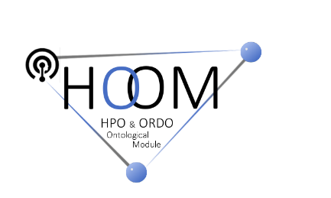
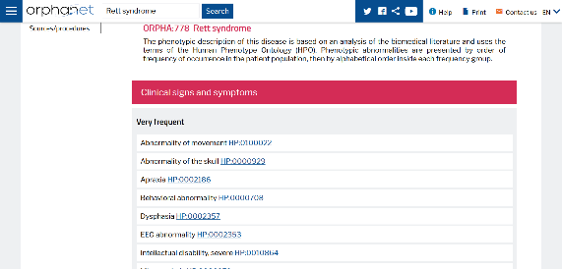
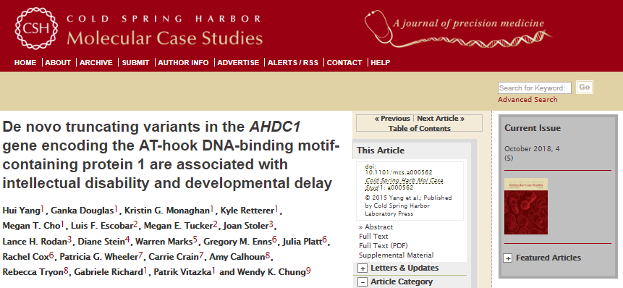
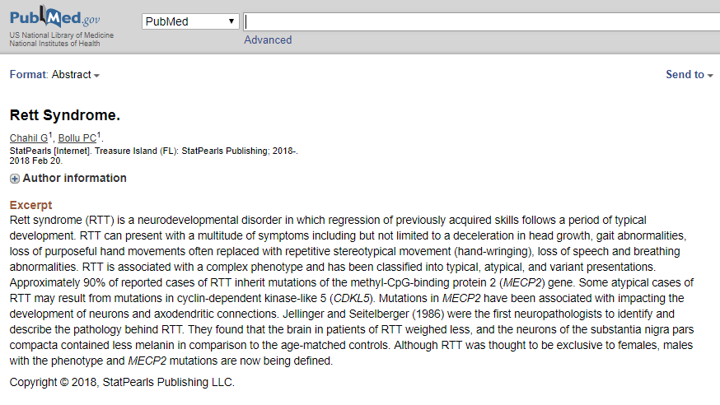
Approaches to reach goals
- Evaluate Orphanet Annotations
- Update and Revise Annotations
- Increase HPO Terms stored in database
- Enrich and Evolve Annotations for new RD
- Improve HPO-ORDO Ontology
- Text Contents Extracted from Orphanet
XML – JSON
- PDF
- URLs (PubMed, Journal Abstracts)
TOOLS TO
BIOHACK
BioHackathon Paris – 12/16 Nov 2018
Notes:
Diapo de Charlotte: frise 20 ans

Slide 7







Exemples of approaches to reach goals
phenopacket-scraper
BioTM - LaSIGE
webapp
IHP
API
core
BioTM - LaSIGE
Hippo
http://labs.rd.ciencias.ulisboa.pt/mer/
https://github.com/lasigeBioTM/MER
https://github.com/KCCG/phenomics-hippo
MER API
Some others exist…
BioHackathon Paris – 12/16 Nov 2018
Notes:
Diapo de Charlotte: frise 20 ans

Slide 8
Technical Tasks and Skills Needed
Day 1-2
Overview of toolkits proposed
Skills:
Python
React JS
Web APIs
XML, JSON
RDF/owl files
Testing\Enhancing of docker IPH- BioTM
Day 3
Testing\Enhancing of MER – BioTM
Testing API and Sources
Day 4
Testing Hippo and try to derive a local Hippo
Replace Pubmed by another source
Expected hacking days: 4 days
BioHackathon Paris – 12/16 Nov 2018
Notes:
Diapo de Charlotte: frise 20 ans

Slide 9
LINKS
David Lagorce david.lagorce@inserm.fr
Phenopacket-Scrapper
https://github.com/monarch-initiative/phenopacket-scraper-core
https://github.com/monarch-initiative/phenopacket-scraper-webapp
https://github.com/monarch-initiative/phenopacket-scraper-api
Phenomics-hippo
https://github.com/KCCG/phenomics-hippo
https://hippo.monarchinitiative.org
IHP
https://github.com/lasigeBioTM/IHP
MER
http://labs.rd.ciencias.ulisboa.pt/mer/
https://github.com/lasigeBioTM/MER
Links
www.orpha.net
www.orphadata.org
https://github.com/Orphanet

